Slide 1


HBASE – THE SCALABLE DATA STORE
An Introduction to HBase
XLDB Europe Workshop 2013: CERN, Geneva
James Kinley
EMEA Solutions Architect, Cloudera

Slide 2
“Apache HBase is the Hadoop database, a distributed, scalable, big data store.”
— The Apache Software Foundation

Slide 3
Why Hadoop and HBase?
Datasets are constantly growing and intake soars
CERN stores 100PB of physics data, with 75PB being generated in past 3 years
Traditional databases are expensive to scale and inherently difficult to distribute
Commodity hardware is cheap and powerful
Hadoop…
Is designed to store and process extremely large datasets in batch
Is not intended for realtime querying
Does not support random access

Slide 4
History of Hadoop and HBase
Google solved its scalability problems
“The Google File System” published October 2003
Hadoop DFS
“MapReduce: Simplified Data Processing on Large Clusters” published December 2004
Hadoop MapReduce
“BigTable: A Distributed Storage System for Structured Data” published November 2006
HBase

Slide 5
What is HBase?
Distributed
Column-Oriented
Multi-Dimensional
High-Availability (CAP?)
High-Performance
Storage System
Project Goals:
Billions of Rows * Millions of Columns * Thousands of Versions
Petabytes of data stored across thousands of commodity servers

Slide 6
HBase is not…
A SQL Database
No native query engine, no SQL, no types, no joins
Transactions and secondary indexes only as add-ons but immature
A drop-in replacement for your RDBMS
You must be ok with RDBMS anti-schema
Denormalized data
Wide and sparsely populated tables
Just say “no” to your DBA

Slide 7
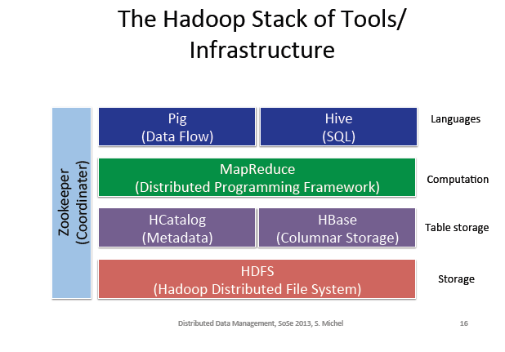

Slide 8
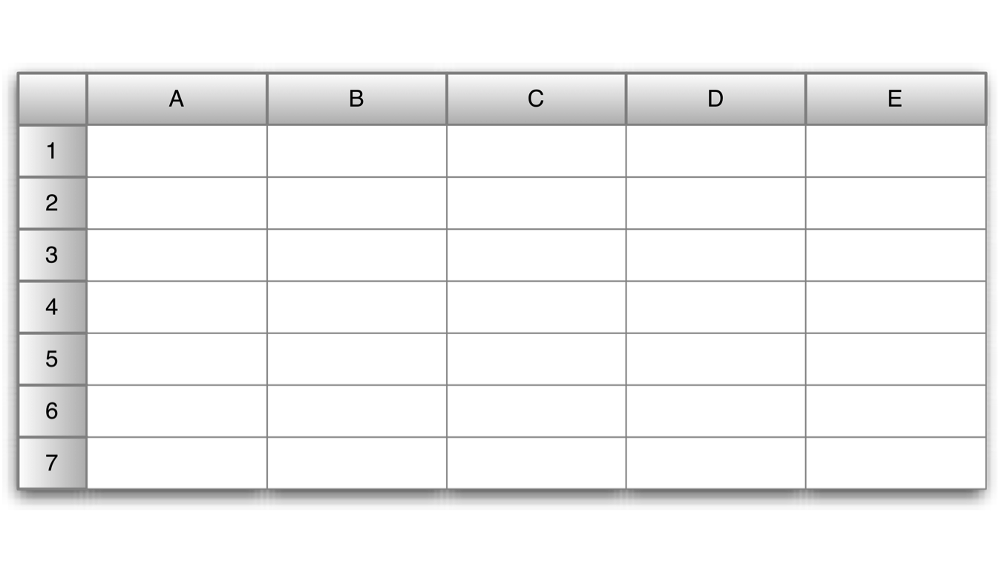
HBase tables

Slide 9
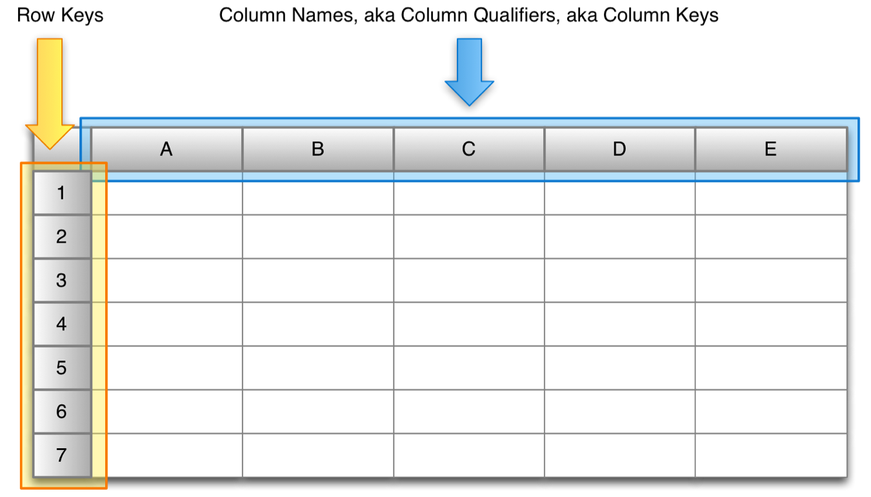
HBase tables

Slide 10
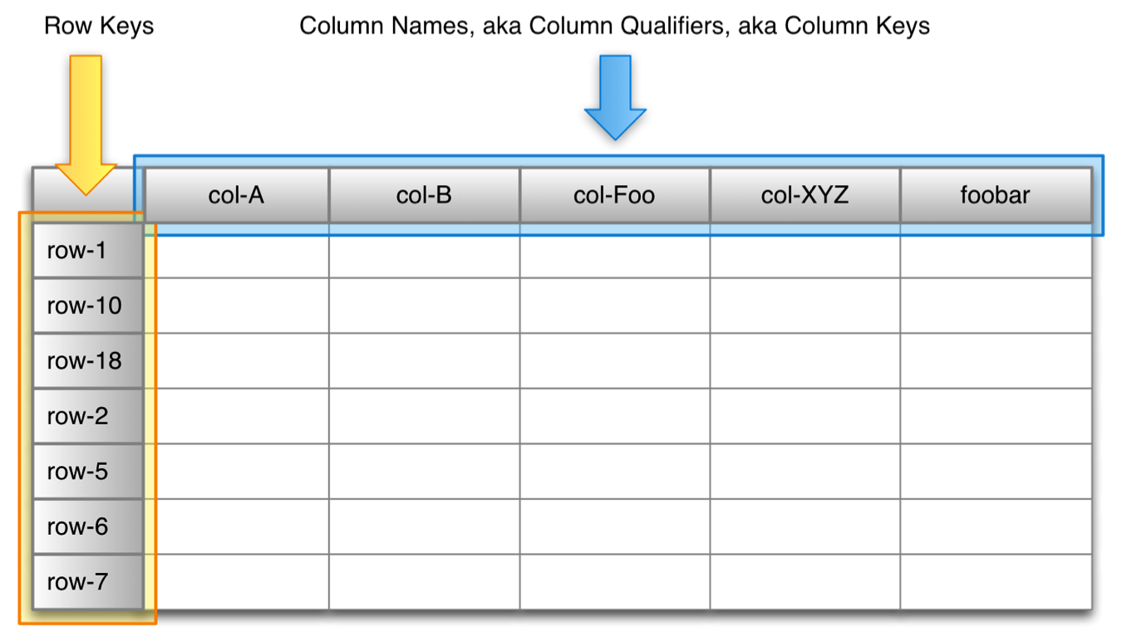
HBase tables

Slide 11
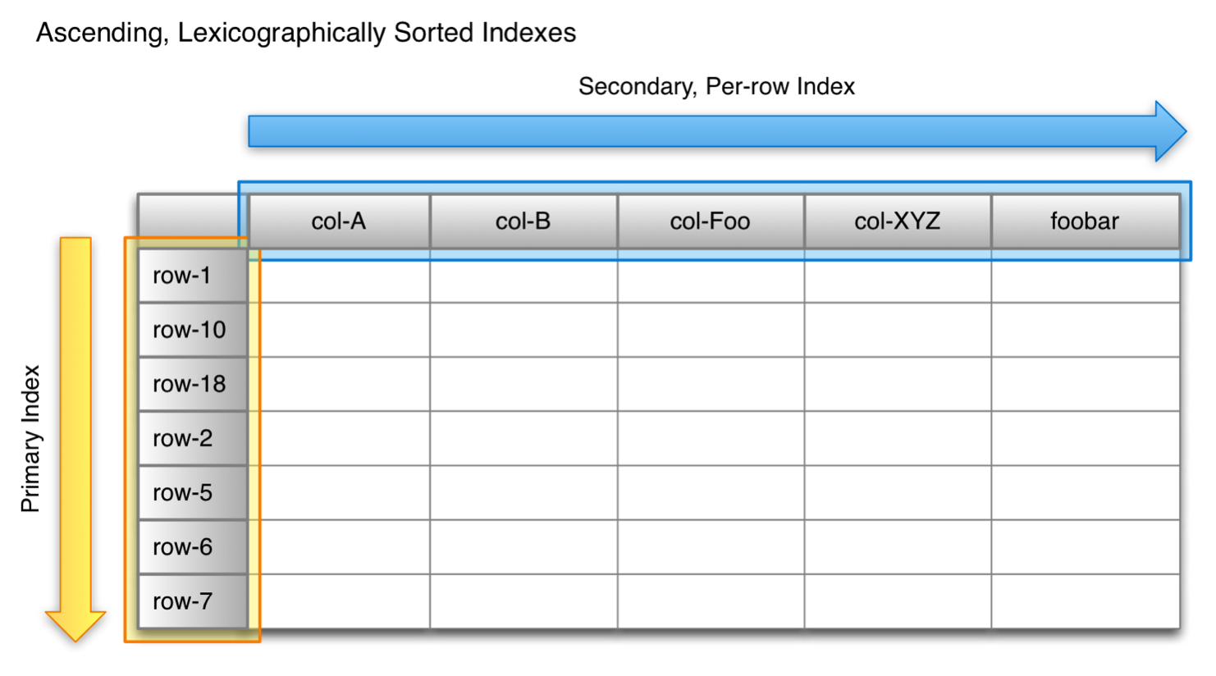
HBase tables

Slide 12
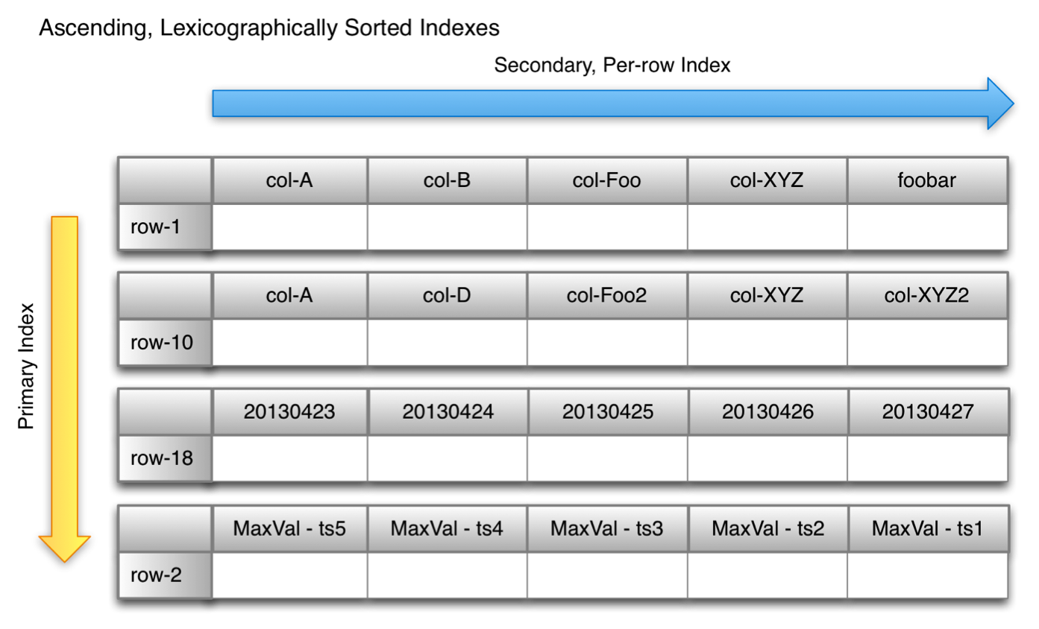
HBase tables

Slide 13
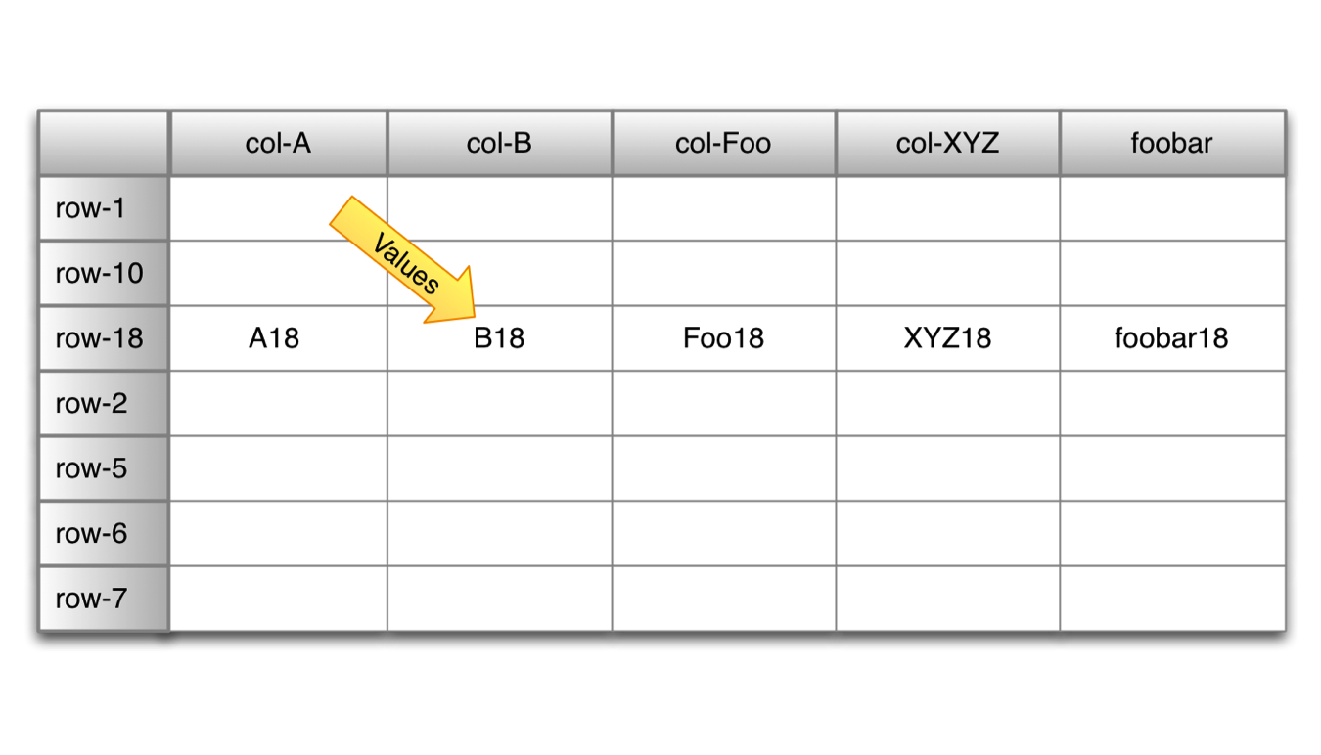
HBase tables

Slide 14
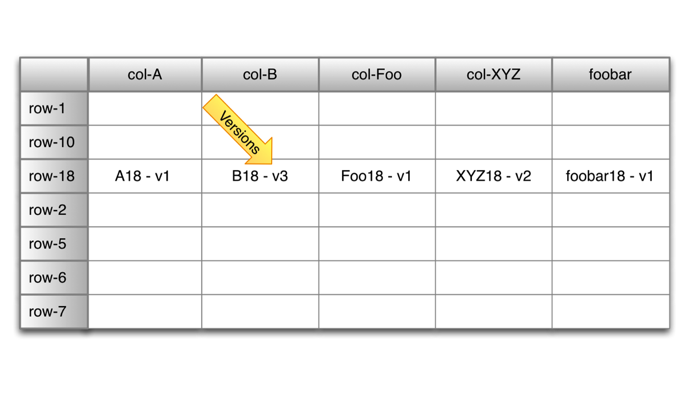
HBase tables

Slide 15
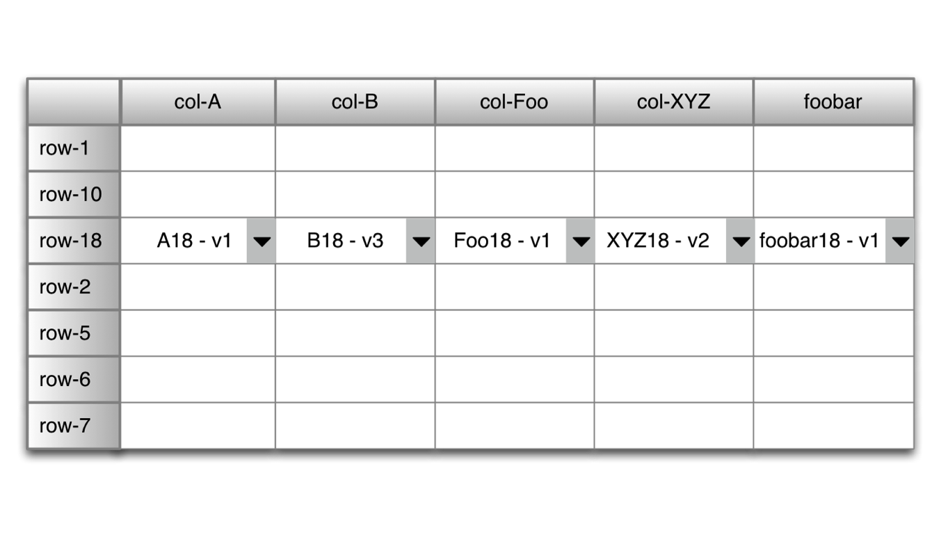
HBase tables

Slide 16
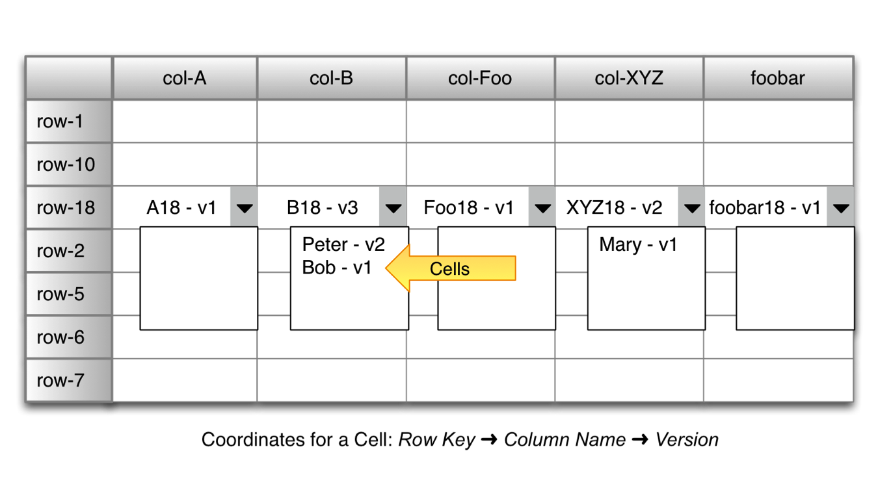
HBase tables

Slide 17
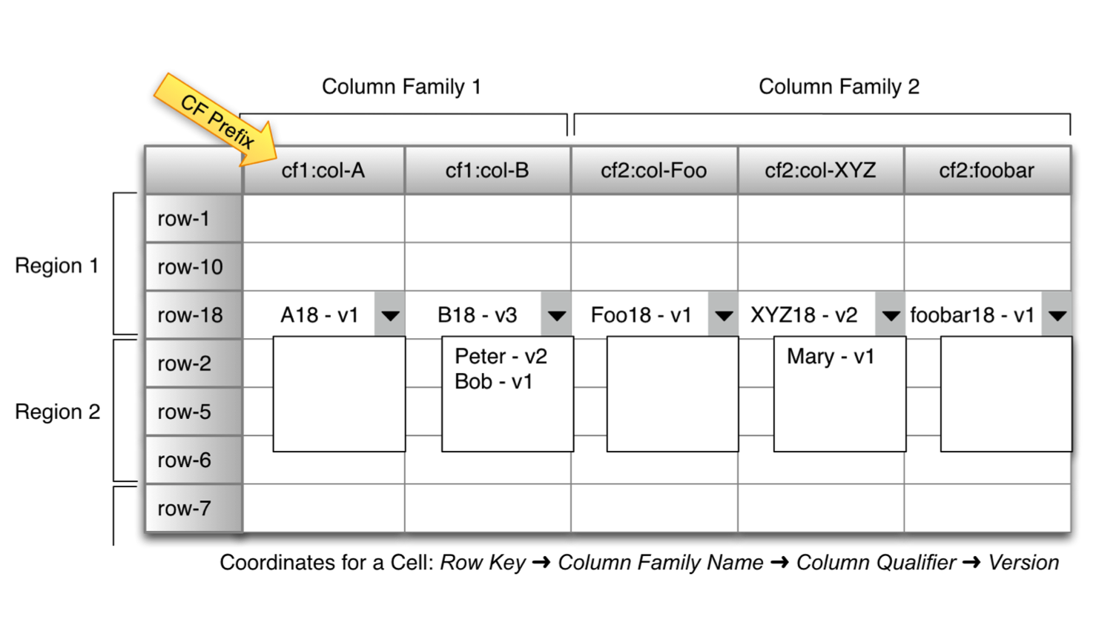
HBase tables

Slide 18
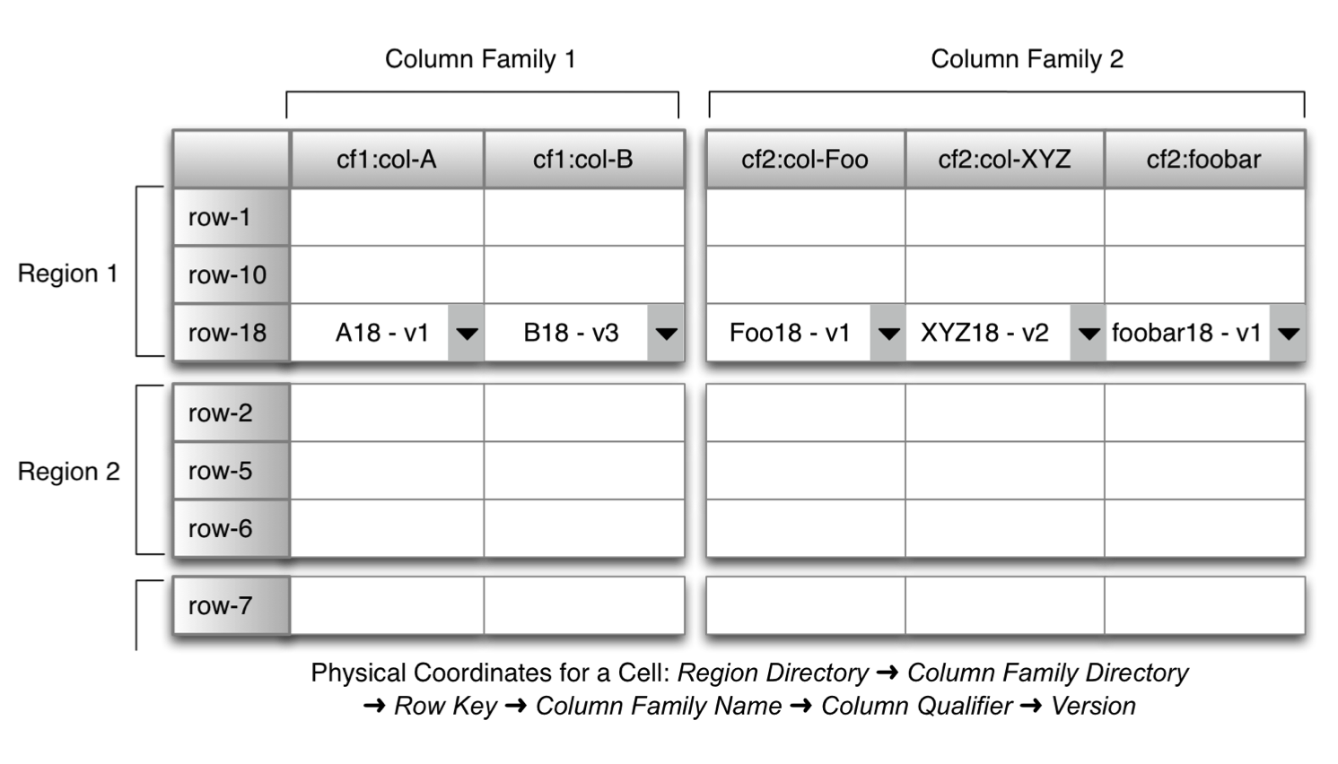
HBase tables

Slide 19
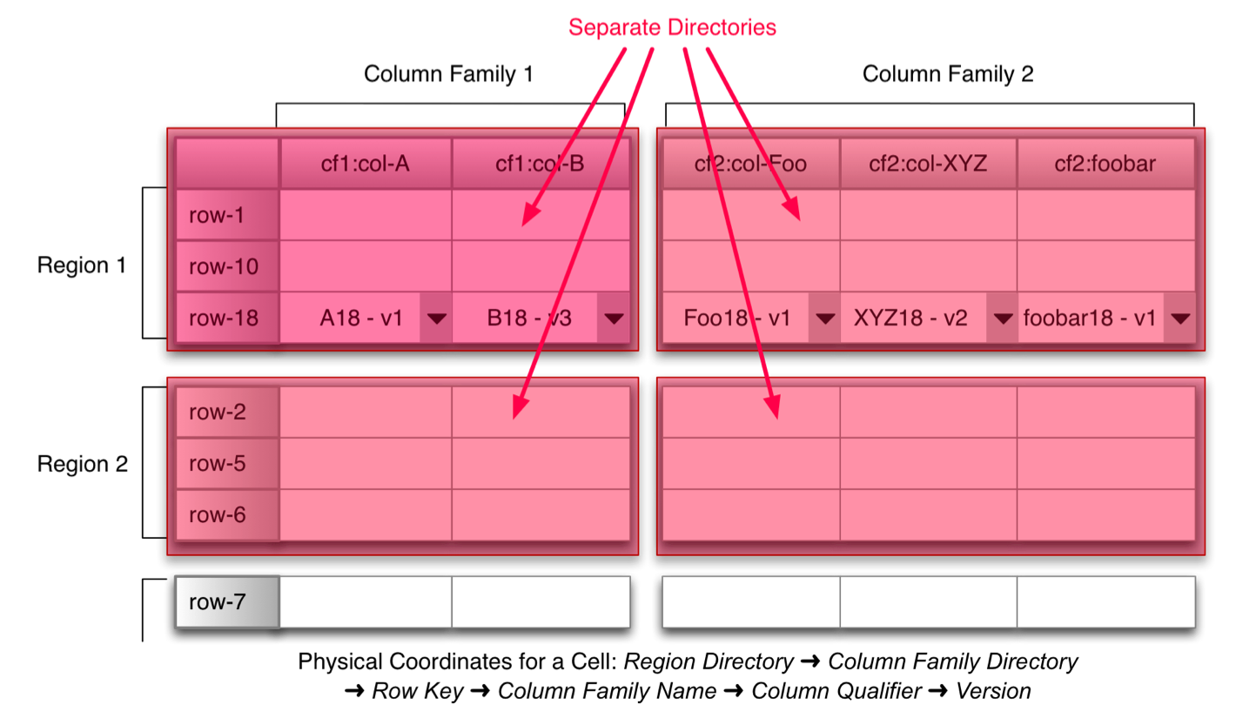
HBase tables

Slide 20
HBase tables
Tables are sorted by Row Key in lexicographical order
Table schema only defines its Column Families
Each family consists of any number of Columns
Each column consists of any number of Versions
Columns only exist when inserted, no NULLs
Columns within a family are sorted and stored together
Everything except table name are byte[]
(Table > Row Key > Family:Column > Timestamp) > Value

Slide 21
HBase Architecture
Table is made up of any number of regions
Region is specified by its startKey and endKey
Each region may live on different node and is made up of several HDFS files and blocks
Two types of node: Master and RegionServer
Special tables -ROOT- and .META. store schema information and region locations
Master server monitors RegionServers as well as region assignment and load balancing
Uses ZooKeeper for distributed coordination

Slide 22
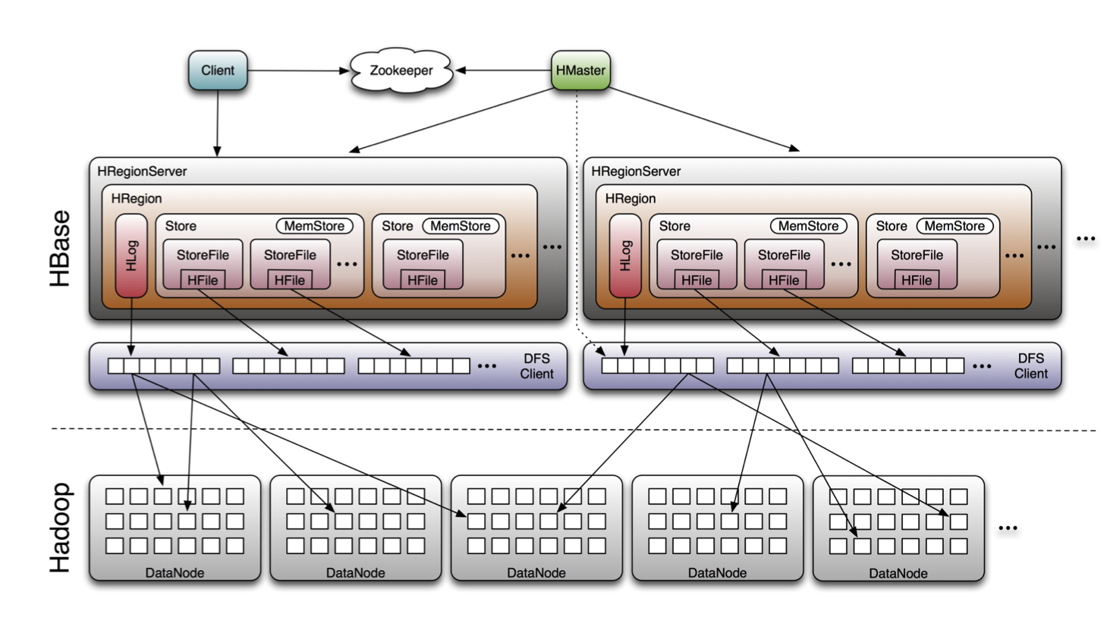
HBase Architecture

Slide 23
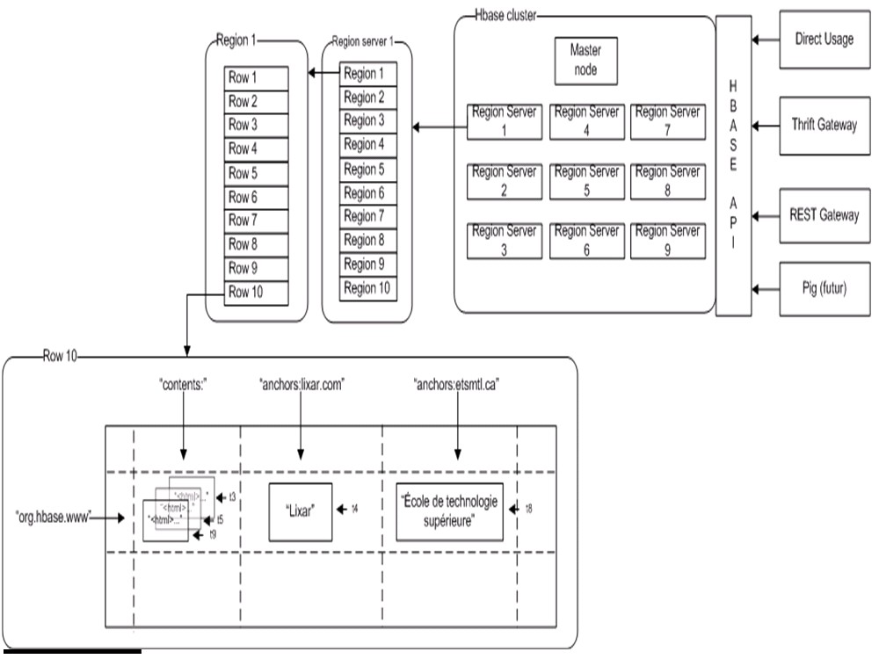

Slide 24
Impala
Open-source, general-purpose SQL query engine
Runs directly within Hadoop:
Reads widely used Hadoop file formats and HBase tables
Talks to widely used Hadoop storage managers
Runs on the same nodes that run Hadoop processes
High performance
C++ instead of Java
Runtime code generation (LLVM)
A completely new execution engine that doesn’t build on MapReduce

Slide 25
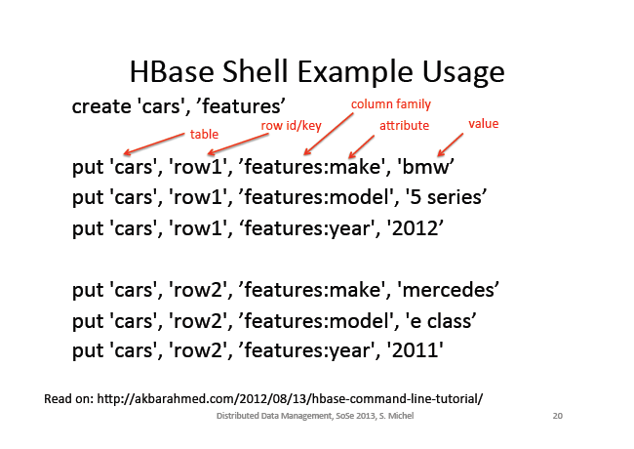

Slide 26
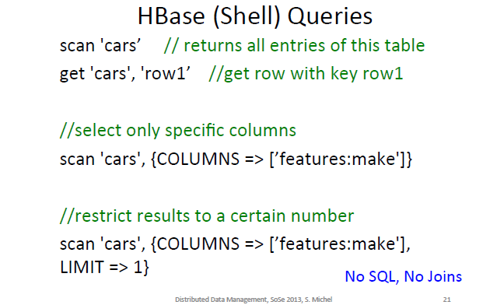

Slide 27
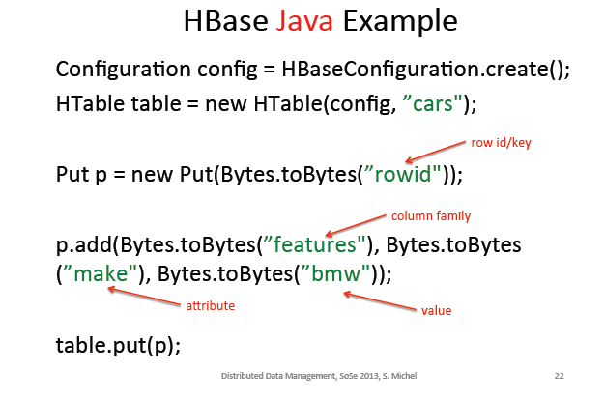

Slide 28
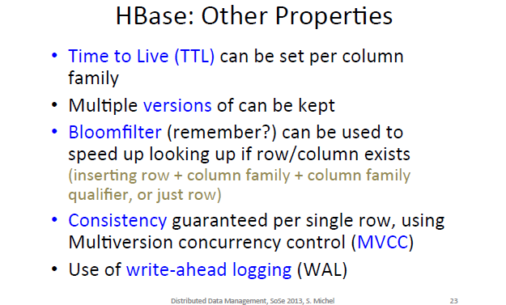

Slide 29

Thank You!
James Kinley, EMEA Solutions Architect, Cloudera
kinley@cloudera.com
@jrkinley

